Slide 1
2019 Bethel Study
21st Annual
Financial Aid Survey of CCCU Institutions
December 4, 2019 – Reno, NV
Dan Nelson: Chief Institutional Data & Research Officer
Jeff Olson: Director of Financial Aid
Stef Holm: Institutional Data & Research Senior Lead

Slide 2

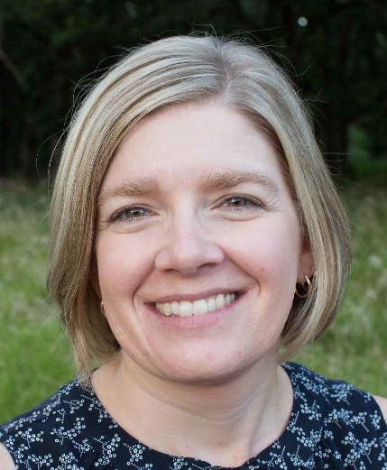
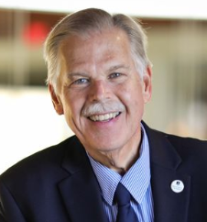
Authors
Stef Holm
Jeff Olson
Dan Nelson

Slide 3
Presentation Overview
1. Survey Participants
  Survey Demographics
  Enrollment
2. Financial Health Indicators
  Tuition & Fee Revenue
  Discount Rates
  Need
  Wealth Index
  Net Tuition Revenue
3. Hot Topics
  Timing of New Student Awards
  Income Share Agreements
  Tuition Resets
  Strategic Academic Partnerships
4. 2019 Survey Themes
  Use of Technology in financial aid office
  Financial Aid Software
  Preferred Lender List
  Financial Aid in Organizational Structure
  Financial Aid Office Operational Budgets
  Employee Tuition Remission/Discounts
  Financial Aid for Study Abroad Programs
  Documents required before awarding aid
  5. Affordability Indicators
  Cost of Attendance Budgets
  Financial Aid
  Student Debt
  Net Price / Family Ability to Pay
  5. Implications for our Schools (discussion)
Notes:
Context
Aspire to Best Practices – try to identify 1 topic to explore on your campus
Institutional Perspectives
Student & Family Perspectives
What next?

Slide 4
Survey Participants
Survey Demographics
Enrollment

Slide 5
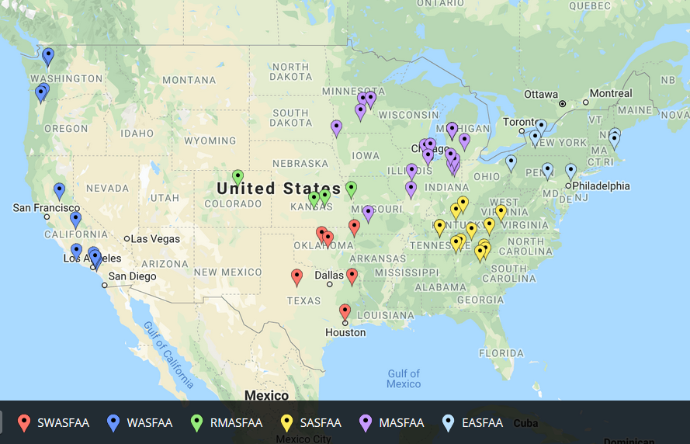
60 Participants – Nov. 19
http://batchgeo.com/
Notes:
1.) 2012-2014 – participation in low 80s
2.) 2015 about 75 participants
3.) 2016-2018 participation in low 60s
- Some regular participants no longer CCCU members
- 37 schools participated in last 5 surveys (2013-2018)
Load demographic data into the following website to generate map
https://batchgeo.com/
https://batchgeo.com/map/f00246fbee090081ded05535ace4d44b

Slide 6

Profile of Responding Schools
(see p. 3)
60 Schools in Cohort
CCCU Members
  Governing Member 87% (52/60)
  Associate Member 10% (6/60)
  Collaborative Partner 3% (2/60)
NASFAA Members
  Yes 95% (57/60)
  No 5% (3/60)
29 Schools participated in the 5 most recent CCCU Financial Aid surveys (down 8 from last year)
9 Schools have participated in all 21 CCCU Fin Aid surveys!
Notes:
Participants in al 17 surveys
Anderson University, IN Bethel University, MN Calvin College, MI Cedarville University, OH Houghton College, NY John Brown University, AR Messiah College, PA Roberts Wesleyan College, NY Tabor College, KS Taylor University, IN University of Northwestern - St Paul, MN Westmont College, CA Wheaton College, IL
50 schools participating in last 5 surveys:
Abilene Christian University, TX Anderson University, IN Arizona Christian University, AZ Asbury University, KY Bethel University, MN Biola University, CA Calvin College, MI Cedarville University, OH Colorado Christian University, CO Columbia International University, SC Cornerstone University, MI Crown College, MN East Texas Baptist University, TX Geneva College, PA George Fox University, OR Gordon College, MA Grace College, IN Greenville College, IL Houghton College, NY Indiana Wesleyan University, IN John Brown University, AR Kuyper College, MI Lee University, TN Lincoln Christian University, IL Malone University, OH Messiah College, PA Milligan College, TN Northwest Christian University, OR Northwest Nazarene University, ID Nyack College, NY Oklahoma Baptist University, OK Oklahoma Christian University, OK Olivet Nazarene University, IL Point Loma Nazarene University, CA Roberts Wesleyan College, NY Simpson University, CA Spring Arbor University, MI Tabor College, KS Taylor University, IN Toccoa Falls College, GA Trinity Christian College, IL Trinity International University, IL University of Northwestern - St Paul, MN University of the Southwest, NM University of Valley Forge, PA Warner Pacific College, OR Waynesburg University, PA Westmont College, CA Wheaton College, IL William Jessup University, CA

Slide 7
9 Schools
Participated in all 21 studies
Bethel University, MN
Calvin College, MI
Houghton College, NY
John Brown University, AR
Messiah College, PA
Roberts Wesleyan College, NY
Taylor University, IN
University of Northwestern - St Paul, MN
Westmont College, CA
Notes:
2018 1st time participants
Ouachita (wa –chee-tah) Baptist University, Arkansas
Pepperdine University, California

Slide 8
2019 Profile - Regional Distribution (see p. 3)

Slide 9
Highest Degree Offered (see p. 3)

Slide 10
2018-’19 Enrollment (see p. 4)
Of the 60 respondents:
  47 (78%) report non-traditional undergrads
  56 (93%) report graduate students
Total Fall ‘18 undergraduate enrollment in traditional programs was 89,371 (for the 60 reporting schools).
Total year grad and undergrad enrollment was 188,544 (as reported on FISAP)
Notes:
2018:
Bachelor as highest degree offered at only 6.4% of participants, down from average of 10.9% over previous 5 surveys
56 schools reported graduate
Non-trad 1415: 75%
Grad 1415: 92%
Undergrad trad enrollment 1415: 116,580
Total enrollment 1415: 238,311
Non-trad 75% last year (1314)
Grad 89% last year (1314)

Slide 11
Traditional Undergraduate Programs

Slide 15
Financial Health Indicators:
Institution Perspective
  Tuition & Fee Revenue
  Discount Rates
  Need
  Wealth Index
  Net Tuition Revenue

Slide 16
Tuition and Fee Revenue (see p. 18)
Year | Traditional Programs | Non-Traditional Programs | Graduate Programs
‘09-10 | 79.5% | 9.3% | 11.3%
‘10-’11 | 79.1% | 8.8% | 12.1%
‘11-’12 | 78.5% | 10.0% | 11.5%
‘12-’13 | 80.2% | 8.2% | 11.6%
’13-’14 | 80.5% | 8.5% | 11.0%
’14-’15 | 78.8% | 8.8% | 12.4%
’15-’16 | 79.3% | 8.5% | 12.2%
‘16-’17 | 79.6% | 7.3% | 13.1%
‘17-’18 | 74.1% | 6.9% | 19.0%
‘18-’19 | 77.8% | 6.9% | 15.2%
The 60 responding schools reported ’18-’19 tuition & fee revenue of $3.43 Billion
Extrapolating to the entire CCCU membership, tuition & fee revenue at CCCU schools is over $6 Billion annually.
Notes:
9.2% of tuition comes from non-traditional undergrads (8.5% in ’06-’07; 9.2% in ‘05-’06)
11.2% of tuition is from graduate students (10.5% in ‘06-07; 9.5% in ’05-’06)
The percent of tuition from traditional undergrads decreased from 81.3% in ’05-’06; to 81.0% in ’06-’07; to 79.6% in ‘08-'09

Slide 17
How Dependent are Schools on Student and Family Loans? (see p. 61)
Traditional Undergraduate Programs
Recorded loans (including PLUS) exceed 50% of tuition & fee revenue at only 0 of 60 reporting schools (0%)
  3% on 2018 survey
Loans are less than 30% of tuition and fee revenue at 36 of 60 schools (60%)
  63% on 2018 survey
  52% on 2017 survey
The median percentage is 29.0%, compared with
  27.6% on 2018 survey
  29.3% on 2017 survey
  31.0% on 2016 survey
Notes:
2017 story – we’re less reliant on loans

Slide 18
Percentage of 2018-19 Institutional Gift Aid (IGA) that is “funded” (see p. 41)
Traditional Undergraduate Programs
The typical (median) school reports that 4.9% of institutional gift aid (not including tuition remission) has a specific funding source (endowed or restricted).
  6 schools report that over 15% of IGA is funded.
  3 schools report between 10-15% of IGA is funded
  21 schools report between 5.0-9.9% of IGA is funded
  30 schools report that less than 5% of IGA is funded
Notes:
Fall 2018 survey data below
The typical (median) school reports that 3.9% of institutional gift aid (not including tuition remission) has a specific funding source (endowed or restricted).
3 schools report that over 15% of IGA is funded.
9 schools report between 10-15% of IGA is funded
15 schools report between 5.0-9.9% of IGA is funded
35 schools report that less than 5% of IGA is funded
Fall 2015 survey data (2014-15) below:
5 schools report that over 15% of IGA is funded.
10 schools report between 10-15% of IGA is funded
13 schools report between 5.0-9.9% of IGA is funded
47 schools report that less than 5% of IGA is funded
Fall 2016 data below
The typical (median) school reports that 4.1% of institutional gift aid (not including tuition remission) has a specific funding source (endowed or restricted).
3 schools report that over 15% of IGA is funded.
4 schools report between 10-15% of IGA is funded
18 schools report between 5.0-9.9% of IGA is funded
39 schools report that less than 5% of IGA is funded

Slide 19
Discount Rate Calculation
Unfunded
  "Unrestricted Institutional gift aid" divided by "tuition and fee revenue"
NACUBO
  (Unrestricted institutional gift aid + endowed + restricted) divided by "tuition and fee revenue"
Neither calculation includes employee tuition remissions

Slide 20
2018-19 Discount Rates (All Students)
(see pp. 114-119)
Traditional Undergraduate Programs
60 schools reported Unfunded discount rates from 11.5% to 60.8% (next lowest was 18.3%)
  1st Quartile: 41.7% (39.9 last year)
  2nd Quartile (median): 44.8% (43.3% last year)
  3rd Quartile: 49.9% (47.4% last year)
The NACUBO discount rate for the same schools ranged from 18.7% to 64.0%
  1st Quartile: 44.3% (43.2% last year)
  2nd Quartile (median): 48.2% (46.1% last year)
  3rd Quartile: 53.6% (50.2% last year)
Notes:
NACUBO last year 25.2% to 61.8%

Slide 21
Estimated 2019-20
Discount Rates (All students) (see pp. 120-127)
Traditional Undergraduate Programs
50 schools reported estimated Unfunded discount rates from 24.3% to 73.0%
  1st Quartile: 41.8% (40.8% last year)
  2nd Quartile (median): 46.7% (45.6% last year)
  3rd Quartile: 49.4% (49.4% last year)
The estimated NACUBO discount rate for the same schools ranged from 28.1% to 74.2%
  1st Quartile: 45.3% (43.5% last year)
  2nd Quartile (median): 49.5% (48.0% last year)
  3rd Quartile: 52.0% (52.3% last year)
Notes:
Avg Unfunded up 1.7% and median up 1.5% compared to 2016 survey (est 1617)
2016 survey: 64 schools reported estimated Unfunded discount rates from 24.3% to 59.8%
2016 survey: The estimated NACUBO discount rate for the same schools ranged from 25.6% to 60.8%

Slide 22
Traditional Undergraduate Programs

Slide 23
Traditional Undergraduate Programs

Slide 24
“Target” Unfunded Discount Rate for 2019-20 New Students (see p. 129)
Traditional Undergraduate Programs
 | New Student Target Rate | All Student Estimated Rate | Gap
Minimum | 21.0% | 18.0% | +3.0 Points
First Quartile | 45.0% | 41.8% | +3.2 Points
Median | 51.9% | 46.7% | +5.2 Points
Third Quartile | 55.2% | 49.4% | +5.8 Points
Maximum | 65.0% | 63.6% | +1.4 Points

Slide 25
2018-19 Needy/Not Needy
(see p. 149)
Traditional Undergraduate Programs
65.7%* percent of students at 51 responding schools were needy (range: 46.5% to 93.2%).
  Total gift aid to needy students = $1.13 billion
  Weighted average total gift aid per needy student = $19,001 ($18,217 last year)
  * weighted average
Notes:
Fall 2016 survey (2015-16 data)
Weighted Avg: 69,119 needy students / 98,754 FISAP enrollment for schools who reported needy students= 70.0%
Fall 2015 survey below (2014-15 data)
73.1% percent of students at 74 responding schools were needy (range: 30.6% to 92.5%). [update 11.29.2016 unweighted avg 72.1%; weighted avg 71.1%]
Total gift aid to needy students = $1.36 billion
Average gift aid per needy student = $15,041 ($14,601 last year)
Fall 2016 slide:
70.0%* percent of students at 64 responding schools were needy (range: 44.8% to 90.0%).
Total gift aid to needy students = $1.05 billion
Average total gift aid per needy student = $15,843 ($15,041 last year)

Slide 26
Traditional Undergraduate Programs

Slide 27

How Needy are our Students?
(see p. 151)
Traditional Undergraduate Programs
The average needy student in 2018-19 at responding schools had demonstrated need of $31,641 (range: $17,244 to $42,280)
On average, responding schools meet 60.1% of need with gift aid
  Minimum: 35.6%
  1st Quartile: 54.4%
  2nd Quartile (median): 58.3%
  3rd Quartile: 67.2%
  Maximum: 78.8%

Slide 28
Traditional Undergraduate Programs

Slide 29
2018-19 Non-Need Students
(see p. 171ff.)
Traditional Undergraduate Programs
Percentage of non-need students receiving gift aid
16 of 49 (33%) schools gave non-need gift aid to over 97% of their non-need students
  Minimum = 27.2%
  1st quartile = 76.2%
  Median = 92.1%
  3rd quartile = 98.6%
  Max = 100% (6 schools)
Average total gift aid per non-need aid recipient
  Minimum = $1,778
  1st quartile = $10,796
  Median = $13,089
  3rd quartile = $16,814
  12 schools over $17,000
  Max = $25,960
Weighted average total gift aid per needy recipient $19,001
Notes:
Question – how much do we respond to students’ documented need with institutional gift aid?
1819 Weighted Average Total Gift Aid per enrolled student = $16,378

Slide 30
Sticker Price vs. Avg. Revenue
(see p. 153ff.)
Traditional Undergraduate Programs
The median school reported average T&F revenue of 90% of their tuition “sticker price” (this represents the effect of less than full-time and less than full-year students).
The range was from 65% to 99%
Notes:
We use this indicator to detect possible data error.
We ask schools to report their FISAP tuition and fee revenue separated between traditional and non-traditional programs. In theory, if every student were enrolled full-time for the full-year the product of “sticker price” x “total enrollment” would equal 100% of FISAP tuition and fee revenue. The degree to which a school’s percentage is less than 100% describes the extent of “less than full-time” and “less-than full-year” attendance.
Schools who report a ratio greater than 100% have likely misreported their data.

Slide 31
Price compared with Family Wealth
(see p. 157ff.)
Traditional Undergraduate Programs
The "wealth index" is an approximate measurement of expected parent contribution from non-independent student families (whether or not they show need).
A positive variance means that, compared to other reporting schools, families are wealthier than the norm.

Slide 32
Price Compared with Family Wealth: 2018-19
Traditional Undergraduate Programs

Slide 33
Traditional Undergraduate Programs
Notes:
1819 data (derived from 2016 taxes)
1718 data from 2015 taxes
1617 data from 2015 taxes

Slide 34
Traditional Undergraduate Programs
Notes:
Wealth went up 7.6% at schools that reported both 2014-15 and 2015-16 data. The average increase was $1204 among schools that reported both 2014-15 and 2015-16.

Slide 35
Wealth Index - Additions
Traditional Undergraduate Programs
Family wealth compared with Net Price (TFRB – Average Total Gift Aid). The average Net Price was $22,721
    $22,412 last year (2018 survey)
    $21,591 two years ago (2017 survey)
Family wealth compared with Net Revenue (TFRB – Average UIGA). The average Net Revenue was $27,732.
    $27,467 last year (2018 survey)
    $26,057.two years ago (2017 survey)
Notes:
Net price is what the families pay. The change in what families paid slowed this year.
Net revenue is what the schools get. The change in what schools received slowed even more (up 1400 from two years to 1 year ago, only up $265 from last year).

Slide 36
Traditional Undergraduate Programs

Slide 37
Traditional Undergraduate Programs
Notes:
Median – still very flat

Slide 38
Traditional Undergraduate Programs

Slide 39
Traditional Undergraduate Programs

Slide 40
Traditional Undergraduate Programs

Slide 41
2019 Hot Topics
  Timing of New Student Awards
  Income Share Agreements
  Tuition Resets
  Strategic Academic Partnerships

Slide 42
Timing of New Student Awards for 2020 (see p. 249ff.)
Traditional Undergraduate Programs
When will you begin awarding new students for 2020-21?
  39% starting November 2019.
  32% starting December 2019
  20% starting January 2020
  8% starting February 2020
  0% starting March 2020 or later
Notes:
When will you begin awarding new students for 2018-19?
50.0% starting November 2017.
40.3% starting December 2017
6.5% starting January 2018
1.6% starting February 2018
1.6% starting March 2018 or later
When will you begin awarding new students for 2017-18?
53.1% starting November 2016.
32.8% starting December 2016
7.8% starting January 2017
1.5% starting February 2017
4.6% starting March 2017 or later
Change: from F’17 to F’18 awarding
Earlier = 8; 16.0%
Same Month= 33; 66.0%
Later = 9; 18.0%

Slide 43
Income Share Agreements
(see p. 250ff.)
To what extent are you using, or interested in offering, institutionally-funded Income Share Agreements for the following purposes? (54 respondents)

Slide 44
8 CCCU Schools* Completed Tuition Reset since 1516
(see p. 252 ff.)
Traditional Undergraduate Programs
School | Year | Unfunded Discount Rate | Prior Year Tuition | Reset Tuition | $ Change | % Change
Bryan College, TN* | 2021 |  | $27,900 | $16,900 | $11,000 | 39.4%
Cornerstone U., MI | 1819 |  | $27,520 | $24,500 | $3,020 | 11.0%
The Master's Coll. & Sem., CA* | 1819 |  | $33,020 | $25,390 | $7,630 | 23.1%
Eastern Nazarene Coll, MA | 1819 |  | $31,780 | $25,598 | $6,182 | 19.5%
Univ. of Sioux Falls, SD | 1819 |  | $27,980 | $18,280 | $9,700 | 34.7%
Warner Pacific Univ., OR | 1819 |  | $24,500 | $18,660 | $5,840 | 23.8%
Grace College, IN | 1516 |  | $24,670 | $22,450 | $2,220 | 9.0%
Lincoln Christian Univ.,, IL | 1516 |  | $16,050 | $12,900 | $3,150 | 19.6%
* Includes former CCCU member institutions

Slide 45
Strategic Academic Partnerships (see p. 256f)
In 2018-19 how many active strategic academic partnership agreements did your institution have with businesses, churches, or organizations?
54 respondents
See page 256 of the Participant Reports for more information.

Slide 46
2019 Survey Themes
  Use of Technology in financial aid office
  Financial Aid Software
  Preferred Lender List
  Financial Aid in Organizational Structure
  Financial Aid Office Operational Budgets
  Employee Tuition Remission/Discounts
  Financial Aid for students in Study Abroad Programs
  Documents required before awarding aid

Slide 47
Use of Technology
100% - use email reminders
85% - post aid awards to web
75% - Students respond to aid offer online
57% - Use document imaging
40% - Use social media (e.g. Facebook)
22% - Contact students using text message
8% - Use online financial aid chatrooms
Refer to pages 183-188 in the 2019 Participant Reports book to see which schools are using which technologies.

Slide 48
Financial Aid Software:
# Schools, Fall ’19 (see p. 181-182)

Slide 49
Financial Aid Software
Nov ‘19 (see p. 181)

Slide 50
Financial Aid Software Satisfaction – 8 year Comparison (see pp. 181-182)

Slide 51
Switching Financial Aid Packaging Software Vendor in next 1-3 Years
Notes:
The increase in the number of schools who plan to switch Loan Software in the next 1-3 years is likely related to changes to Direct Lending.

Slide 52
Preferred Lender Lists
# of Lenders on List
Do you have a Private Loan Preferred Lender List?
Lenders | Schools
25 | 1
17 | 1
12 | 1
11 | 1
10 | 3
9 | 2
8 | 3
7 | 8
6 | 4
5 | 4
4 | 1

Slide 53
Financial Aid Reporting Relationships (see p. 190)
Where do financial aid offices reside in the school’s organizational structure (60 schools reporting)?

Slide 55
One-Stop Shop (pp. 195-196)
21 Schools reported they are part of a One-Stop Shop.
Abilene Christian University, TX
Bluefield College, VA
Colorado Christian University, CO
Cornerstone University, MI
Eastern Nazarene College, MA
Fresno Pacific University, CA
Geneva College, PA
Gordon College, MA
Grace College, IN
Greenville University, IL
Houghton College, NY
Messiah College, PA
Milligan College, TN
Oklahoma Baptist University, OK
Olivet Nazarene University, IL
Roberts Wesleyan College, NY
Seattle Pacific University, WA
The Moody Bible Institute of Chicago, IL
Trevecca Nazarene University, TN
Warner Pacific University, OR
Wheaton College, IL

Slide 56
Operational Budget Observations (pp. 197-198)
Expenses paid from the financial aid operational budget vary by school. For example, several schools did not report “supplies and expense” because it was located in the admissions budget. See “comments” column in Excel spreadsheet for details.
Scope of responsibilities varies by office. For example, some offices are part of a “one stop shop,” and some perform student employment functions normally assigned to a human resources office.
This theme will be removed from future rotations.

Slide 57
Employee Tuition Remission
(pp. 198-230)
Share information with HR office
  Employee eligibility criteria
  Application deadlines
Employee Tuition Remissions (waivers/ benefits) are referred to as Qualified Tuition Reductions in reports, which is consistent with IRS guidance.

Slide 58
Dependent Definition for Employee Tuition Remission (see pp. 198-200)

Slide 59
Employee Tuition Remission as Percent of Tuition (see p. 204)
 | Minimum |  | Maximum
 | Lowest | Average | Average | Highest
Employees | 20% | 64% | 98% | 100%
Employee’s Spouse | 20% | 59% | 92% | 100%
Employee’s Dependent | 20% | 59% | 97% | 100%

Slide 60
Impact of Gift Aid on Employee Tuition Remission (TR) (see pp. 213-230)

Slide 61
Employee Tuition Remission
Off-campus Programs (see pp. 210-212)
31 of 60 schools (52%) allow students in off-campus programs to utilize Employee Tuition Remission
  48% in 2015
  43% in 2011
  54% in 2007

Slide 62
Pricing of Full-Term Study Abroad Programs
Compared with Residential Programs (see pp. 231-232)
Average % of full-term study abroad students billed _______ than residential programs | 2006-07 (61 schools) | 2010-11 (62 schools) | 2014-15 (57 schools) | 2018-19 (40 schools)
Less | 9% | 13% | 13% | 21%
Similar | 62% | 53% | 58% | 50%
More | 29% | 34% | 29% | 31%

Slide 63
Aid for Students Studying Abroad
(see pp. 233-235)

Slide 64
Off-Campus Studies: # terms
(see pp. 236-238)
For how many terms will you provide institutional funds to students participating in study-abroad programs?
Survey | Dec ‘07 | Nov ’11 | Nov ’15 | Nov ‘19
# Schools | 61 | 70 | 69 | 54
0 terms | 10 = 16% | 17 = 24% | 12 = 17% | 11 = 20%
1 term | 28 = 46% | 32 = 46% | 30 = 44% | 26 = 48%
2 terms | 7 = 12% | 8 = 11% | 10 = 15% | 5 = 9%
3 or 4 terms | 2 = 3% | 1 = 1% | 1 = 1% | 1 = 2%
8+ terms or No limit | 14 = 23% | 12 = 17% | 16 = 23% | 11 = 21%
Notes:
Schools with no limit in Nov ’15 on # of terms:
1 Adjusts IGA up or down depending on cost of program
5 offer same gift aid as on campus
5 reduce IGA, offer same non-inst aid
4 only offer non-institutional aid

Slide 65
Documents required to complete a Financial Aid File: Applying for Need-Based Aid, Not Selected for Verification (see pp.239-241)

Slide 66
Documents required to complete a Financial Aid File: Applying for Non-Need-Based Aid (see pp. 239-247)

Slide 67
Affordability Indicators for Traditional Undergraduate Programs: Student’s Perspective
  Cost of Attendance Budgets
  Financial Aid
  Student Debt
  Net Price / Family Ability to Pay

Slide 68
2019-20 On-campus Budgets (COA for students in Traditional Undergrad Programs) (see p. 20ff.)
Traditional Undergraduate Programs
Average on-campus student budget is $44,125
  Lincoln Christian $27,505
  Westmont $64,240
This is an increase of 2.9% from 2018-19 (compared with a 5.6%* increase from 2017-18 to 2018-19).
  *Up 4.4% without Pepperdine.

Slide 69
Traditional Undergraduate Programs

Slide 70
Tuition & Fee Changes
2018-19 to 2019-20 (see pp. 21-26)
Traditional Undergraduate Programs
Tuition and Fees at 60 reporting schools increased from an average of $29,121 to $30,110 (3.4%).
  ¼ increased tuition by 2.7% or less
    Two schools froze tuition, one schools dropped tuition (-0.3%)
  ¼ increased tuition by 2.8% to 3.4%
  ¼ increased tuition by 3.5% to 4.1%
  ¼ increased by more than 4.1%
    The highest reported tuition increase was 6.9%
    8 schools increased tuition more than 5%
Notes:
2019 survey
Tuition and Fees at 62 reporting schools increased from an average of $29,121 to $29,967 (2.8%).
¼ increased tuition by 2.8% or less
Two schools froze tuition, two schools dropped tuition (-11% and -24%)
¼ increased tuition by 2.9% to 3.2%
¼ increased tuition by 3.3% to 3.9%
¼ increased by more than 3.9%
The highest reported tuition increase was 9.8%
2016 survey
Tuition and Fees at 64 reporting schools increased from an average of $25,761 to $26,713 (3.7%).
¼ increased tuition by 2.9% or less
Lowest increase was 0.9% at 2 schools
¼ increased tuition by 3.0% to 3.4%
¼ increased tuition by 3.5% to 4.6%
¼ increased by more than 4.6%
The highest reported tuition increase was 8.4%
Tuition and Fees at 75 reporting schools increased from an average of $25,345 to $26,156 (3.2%).
¼ increased tuition by 2.8% or less
5 schools froze tuition and 2 decreased tuition
¼ increased tuition by 2.9% to 3.4%
¼ increased tuition by 3.5% to 4.6%
¼ increased by more than 4.6%
The highest reported tuition increase was 7.8%

Slide 71
Traditional Undergraduate Programs

Slide 72
Traditional Undergraduate Programs

Slide 73
2019-20 Indirect Budget Items
(see pp. 25-26)
Traditional Undergraduate Programs
Dependent budget estimates for books, supplies, personal and transportation ranged from $2,033 to $7,968.
  Average was $4,272
  This is 0.3% more than 2018-19
  23 of 60 (38%) of schools didn’t change their indirect costs from 2018-19 to 2019-20 (similar to last year (38% and two years ago 35%)
  Change in indirect budget items ranged from -61.9% to +10.3%.

Slide 74
Traditional Undergraduate Programs
Notes:
Includes Tuition Remission

Slide 75
Traditional Undergraduate Programs
Notes:
Includes Tuition Remission

Slide 76

Trends in Pell Grant
(see p 43 and 110)
Traditional Undergraduate Programs
Lowest and highest average Pell Grant (per enrolled student in traditional undergraduate programs):
  2019 Survey: $789 to $2,992
  2018 Survey: $763 to $2,708
  2017 Survey: $696 to $2,375
  2016 Survey: $756 to $3,039
  2015 Survey: $751 to $3,493
  2014 Survey: $771 to $3,340
39 of 60 (65%) schools offer TEACH Grant

Slide 77
Pell Grant as % of Total Enrollment
(see pp. 106-109)
 | Students in Traditional Undergrad Programs |  |  | Students in Non-Traditional Undergrad Programs
 | 2017 Survey | 2018 Survey | 2019 Survey | 2017 Survey | 2018 Survey | 2019 Survey
Minimum | 13.6% | 16.2% | 18.0% | 0% | 0% | 0%
1st Quartile | 29.5% | 27.2% | 25.8% | 30.4% | 32.9% | 35.0%
Median | 34.7% | 33.4% | 33.2% | 44.6% | 46.4% | 46.7%
3rd Quartile | 41.6% | 42.4% | 38.7% | 54.4% | 57.1% | 52.5%
Maximum | 54.4% | 58.2% | 60.6% | 98.1% | 100+% | 72.7%
# Schools reporting Pell recipients | 63 | 62 | 59 | 45 | 43 | 37

Slide 78
Traditional Undergraduate Programs

Slide 79
Traditional Undergraduate Programs

Slide 80
Traditional Undergraduate Programs

Slide 81
Loans 2018-19
(Traditional Undergrad Programs) (see pp. 56-63)
Traditional Undergraduate Programs
60 survey respondents reported $693 million in total borrowing
Of this $166 million was PLUS loans
  Total PLUS borrowing exceeded $5 million at 10 schools
  Average PLUS per enrolled student was $1,698 (down from $1,846 in 2018 survey)
Average amount borrowed per enrolled student was $7,105 (down from $7,503 in 2018 survey)

Slide 82
2018-19 Borrowing: Average per Enrolled Student (see p. 61-62)
Traditional Undergraduate Programs
Perkins $0
Subsidized $2,067
Unsubsidized $1,947
Other $1,394
PLUS $1,698
Total $7,105

Slide 83
Traditional Undergraduate Programs
Notes:
Over past 10 years, median borrowing went up $174 (0809 to 1819) which is 2.45%

Slide 84
Traditional Undergraduate Programs

Slide 85
Traditional Undergraduate Programs

Slide 86
Average Student Loan Debt of Graduates
(see p. 90ff.)
Traditional Undergraduate Programs
On average 70% of FY19 graduates at 55 responding schools borrowed student loans (range: 35% to 93%).
Their average debt was $29,348 (range: $18,923 to $40,973).
  28 of 55 (50%) of responding schools had average debts ranging from $26,534 to $32,538
The average debt, at schools where students borrowed, equaled 107% of 2018-2019 tuition and fees at each student’s school (range: 46% to 212%).
Notes:
Percent borrowed

Slide 87
3-Year Cohort Default Rates
CCCU 2019 Survey Participants
Most recent three-year default rate on government loans (FY2016 official).
64% (37 of 58) of CCCU members participating in 2019 Survey have default rates less than 6.3%, and 95% (55 of 58) of rates are below 10.1%
National Average Default Rate – All Schools (10.1%)
National Average Default Rate – Private 4-Year (6.3%)
SOURCE: U.S. Department of Education Default Management, Official Cohort Default Rates for Schools, retrieved 11.27.2019 https://www2.ed.gov/offices/OSFAP/defaultmanagement/cdr.html

Slide 88
3-Year Cohort Default Rates
Active CCCU Members
Most recent three-year default rate on government loans (FY2016 official).
54% (70 of 129) of CCCU members have default rates less than 6.3%, and 87% (112 of 129) of rates are below 10.1%
National Average Default Rate – All Schools (10.1%)
National Average Default Rate – Private 4-Year (6.3%)
SOURCE: U.S. Department of Education Default Management, Official Cohort Default Rates for Schools, retrieved 11.27.2019 https://www2.ed.gov/offices/OSFAP/defaultmanagement/cdr.html

Slide 89
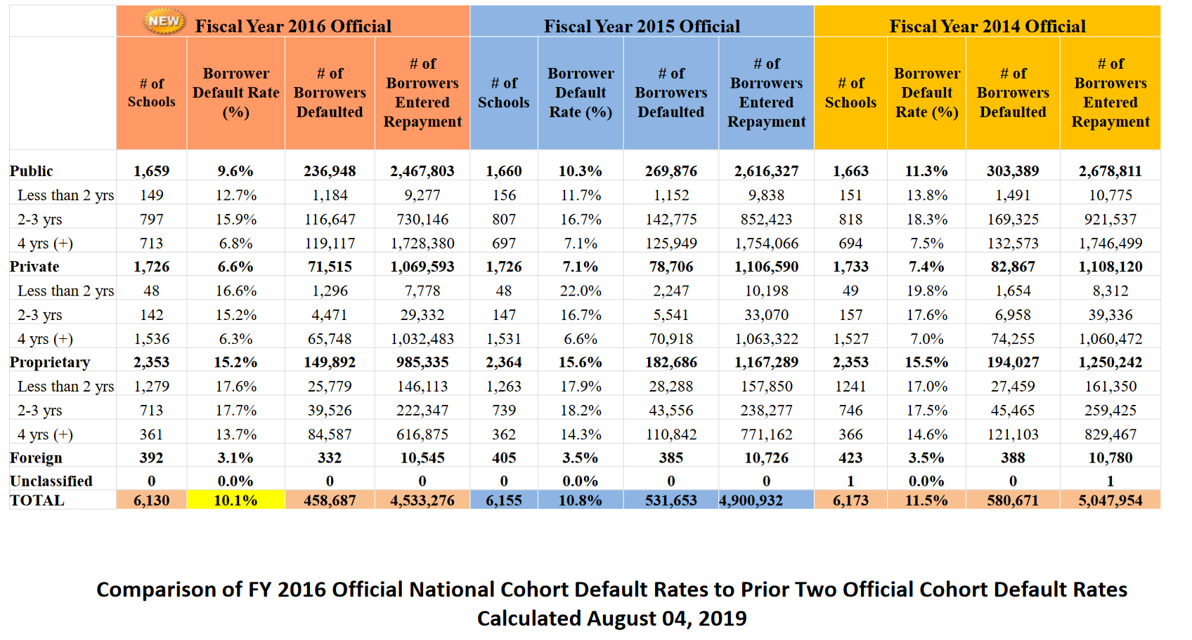
Fiscal Year 2014, 2015, 2016 Cohort Default Rates
SOURCE: U.S. Department of Education Default Management, Official Cohort Default Rates for Schools, retrieved 11.27.2019 https://www2.ed.gov/offices/OSFAP/defaultmanagement/cdr.html

Slide 90
2018-19 Total Financial Aid
(see pp. 64-65)
Traditional Undergraduate Programs
Students in traditional undergrad programs at 60 institutions received $2.2 billion of financial aid in 2018-19.
  $1.631 billion in gift aid (74%)
  $ 526 million in student loans (24%)
  $ 57 million in employment (2%)

Slide 91
Traditional Undergraduate Programs

Slide 92
Traditional Undergraduate Programs

Slide 93
Traditional Undergraduate Programs

Slide 94
Traditional Undergraduate Programs

Slide 95
Implications for our Schools (discussion)

Slide 96

Questions?
Contact Dan Nelson or Jeff Olson if you have specific questions
  dcnelson@bethel.edu
  jeff-olson@bethel.edu
Email the CCCU financial aid administrators e-list to foster a broader conversation

